Slide 1

COMP 499/691: Conversational Artificial Intelligence
Introduction to Deep Learning
(Part 2)
Computer Science & Software Engineering
Concordia University, Winter 2024

Slide 2
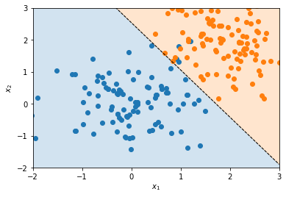
Outline
Vanishing and Exploding Gradients
Normalization
Regularization
Convolutional Neural Networks

Slide 3
Vanishing and Exploding Gradients

Slide 4
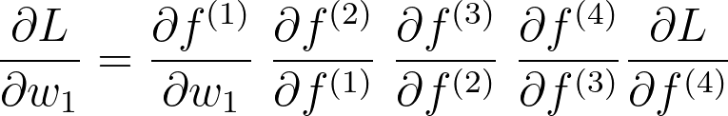
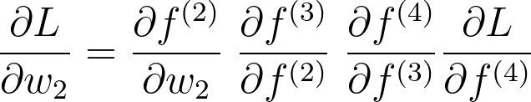
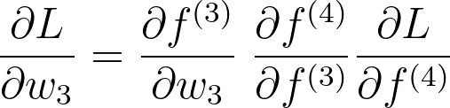
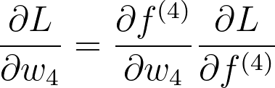
Backpropagation
x
f⁽¹⁾
f⁽²⁾
f⁽³⁾
f⁽⁴⁾
L
input
w1
w2
w3
w4
y
Parameters
Label
Early layers are far away from the final loss function.
Is that critical?
The information coming from the early layers has to undergo many stages before reaching L.
As a result, their final gradient requires a long chain of multiplications (or dot products in a multi-dimensional space).

Slide 5

Vanishing and Exploding Gradients
x
f⁽¹⁾
f⁽²⁾
f⁽³⁾
f⁽⁴⁾
L
input
Vanishing:
0.5 x 0.3 x 0.1 x 0.1 x 0.2 = 0.0003
w1
w2
w3
w4
y
Exploding:
2.5 x 1.3 x 9.9 x 5.4 x 8.2 = 1424
Parameters
Label
When backpropagation the gradient through long chains of computations there a two possible issues:
Vanishing Gradient (often): the gradient gets smaller and smaller.
Exploding Gradient (rare): the gradient gets bigger and bigger.
In multi-dimensional spaces, the multiplications turn into dot products. What causes vanishing and exploding gradients are the eigenvalues of the jacobian matrices.

Slide 6
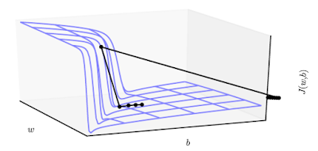
Vanishing and Exploding Gradients
x
f⁽¹⁾
f⁽²⁾
f⁽³⁾
f⁽⁴⁾
L
input
Vanishing:
0.5 x 0.3 x 0.1 x 0.1 x 0.2 = 0.0003
w1
w2
w3
w4
y
Exploding:
2.5 x 1.3 x 9.9 x 5.4 x 8.2 = 1424
Parameters
Label
Gradient Cliff
This causes the parameter space to have very steep areas (exploding gradients) and flat areas (vanishing gradients).
These problems get worse when adding several hidden layers (deep neural networks).
Flat Area

Slide 7
Exploding Gradients
x
f⁽¹⁾
f⁽²⁾
f⁽³⁾
f⁽⁴⁾
L
input
Vanishing:
0.5 x 0.3 x 0.1 x 0.1 x 0.2 = 0.0003
w1
w2
w3
w4
y
Exploding:
2.5 x 1.3 x 9.9 x 5.4 x 8.2 = 1424
Parameters
Label
Exploding gradient causes the gradient of the parameters in the early layers to be very big.
What’s the problem with that?
Can you guess a possible solution?
Too large updates could throw the parameters very far, into a region where the objective function is larger (thus undoing much of the work that had been done to reach the current solution).
Moreover, the magnitude of the weights gets bigger and bigger causing (at some point) numerical issues (e.g, inf).

Slide 8
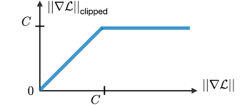
Exploding Gradients
x
f⁽¹⁾
f⁽²⁾
f⁽³⁾
f⁽⁴⁾
L
input
Vanishing:
0.5 x 0.3 x 0.1 x 0.1 x 0.2 = 0.0003
w1
w2
w3
w4
y
Exploding:
2.5 x 1.3 x 9.9 x 5.4 x 8.2 = 1424
Parameters
Label
C is a hyperparameter configured by trial and error.
A solution largely adopted is gradient clipping.
One way to do gradient clipping involves forcing the gradient values (element-wise) to a specific maximum absolute value C.
E.g. if the gradient on my parameters is [-0.3, 0.5, -1000, -0.4] and C=5, my gradient will be [-0.3, 0.5, -5, -0.4 ].
When gradient descent proposes to make a very large step, the gradient clipping intervenes to reduce the step size. This way it is less likely to go outside the region of interest.

Slide 9
Vanishing Gradient
x
f⁽¹⁾
f⁽²⁾
f⁽³⁾
f⁽⁴⁾
L
input
Vanishing:
0.5 x 0.3 x 0.1 x 0.1 x 0.2 = 0.0003
w1
w2
w3
w4
y
Exploding:
2.5 x 1.3 x 9.9 x 5.4 x 8.2 = 1424
Parameters
Label
Vanishing gradient causes the gradient of the parameters in the early layers to be very small.
Can you guess a possible solution?
What’s the problem with small gradients?
The parameters do not change too much during training and they will stay “almost” randomly initialized.

Slide 10
Vanishing Gradient
x
f⁽¹⁾
f⁽²⁾
f⁽³⁾
f⁽⁴⁾
L
input
Vanishing:
0.5 x 0.3 x 0.1 x 0.1 x 0.2 = 0.0003
w1
w2
w3
w4
y
Exploding:
2.5 x 1.3 x 9.9 x 5.4 x 8.2 = 1424
Parameters
Label
Several solutions to mitigate this problem have been proposed. Popular approaches are:
Non-saturating activation functions
Initialization
Gradient shortcuts
Normalization
Fighting vanishing gradients is a central problem in deep learning. It is an active research area.

Slide 11
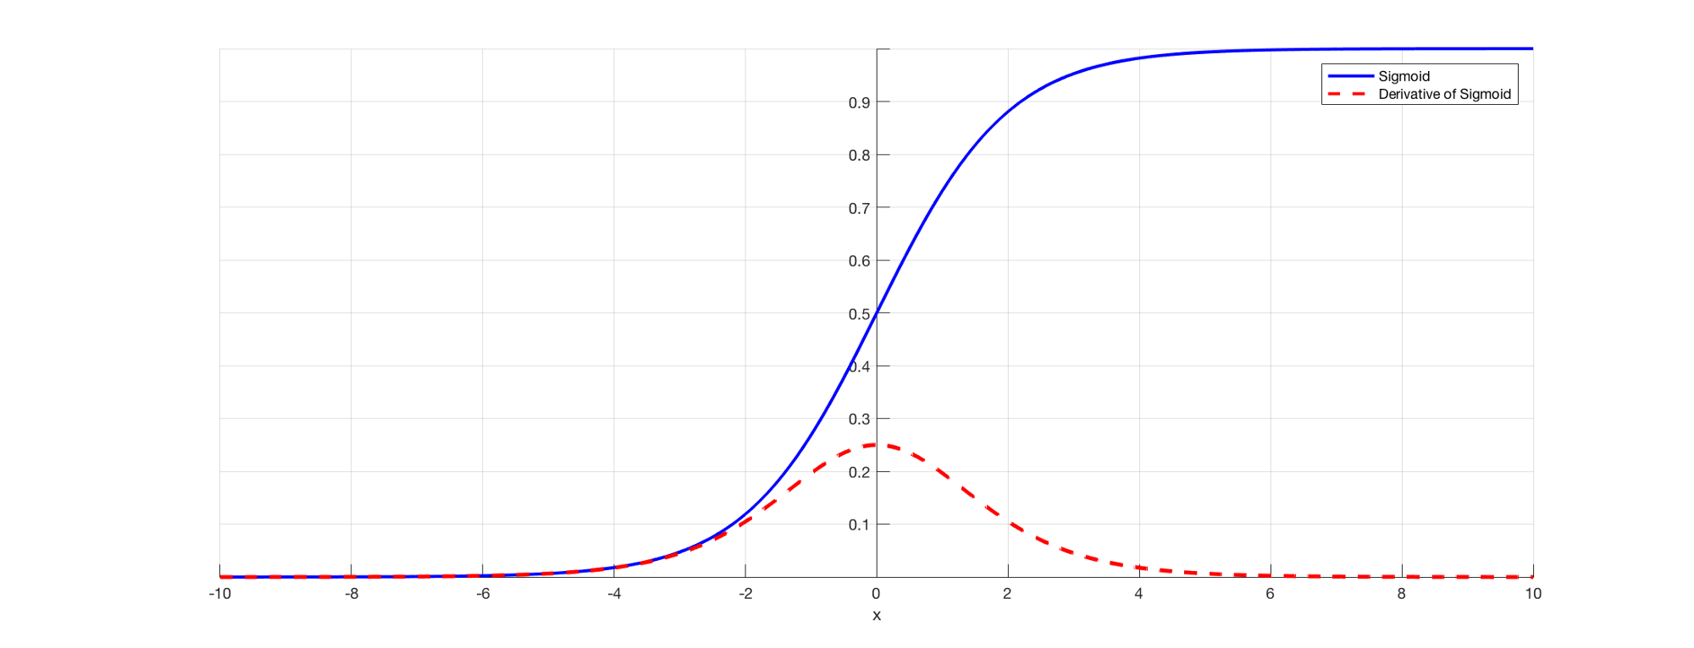
Saturating Activation Functions
x
f⁽¹⁾
f⁽²⁾
f⁽³⁾
f⁽⁴⁾
L
input
w1
w2
w3
w4
y
Parameters
Label
Saturation point
Saturation point
Sigmoid and Tanh activation functions have two saturation points where the gradient is close to zero.
This causes the final gradient to be small as well.
We have to avoid using these functions as activations of the hidden layers.
Notes:
This causes the final gradient to be small as well.

Slide 12
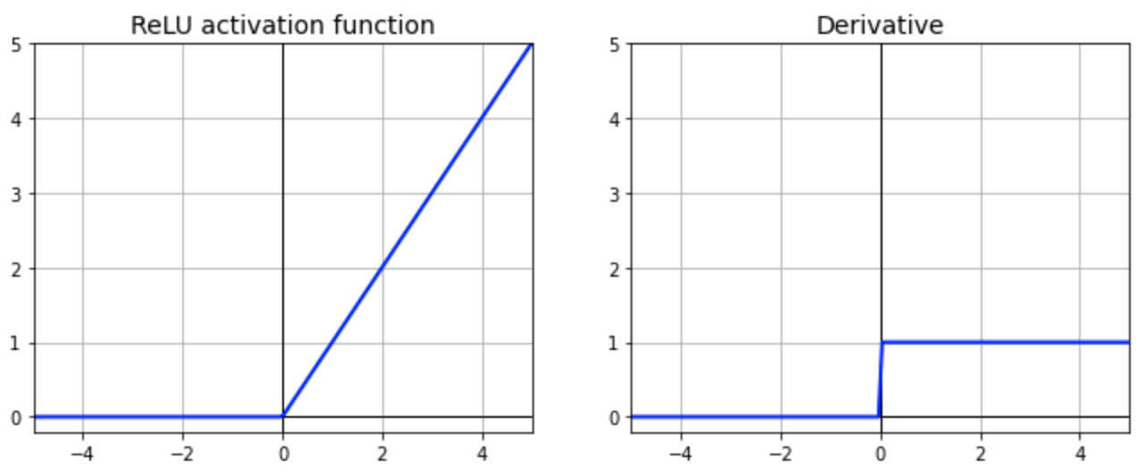
Non-saturating Activation Functions
x
f⁽¹⁾
f⁽²⁾
f⁽³⁾
f⁽⁴⁾
L
input
ReLU
w1
w2
w3
w4
y
Parameters
Label
Solution 1: Avoid saturating activation functions (e.g., Sigmoid and Tanh)
Alternatively, we can use ReLUs.
If x > 0, the derivative is one and the gradient can flow unchanged.
If x < 0, the derivative is zero and we have vanishing problems.
However, this happens only on one side, and not on both sides as for sigmoids and tanhs (thus alleviating this problem)
Notes:
This causes the final gradient to be small as well.

Slide 13
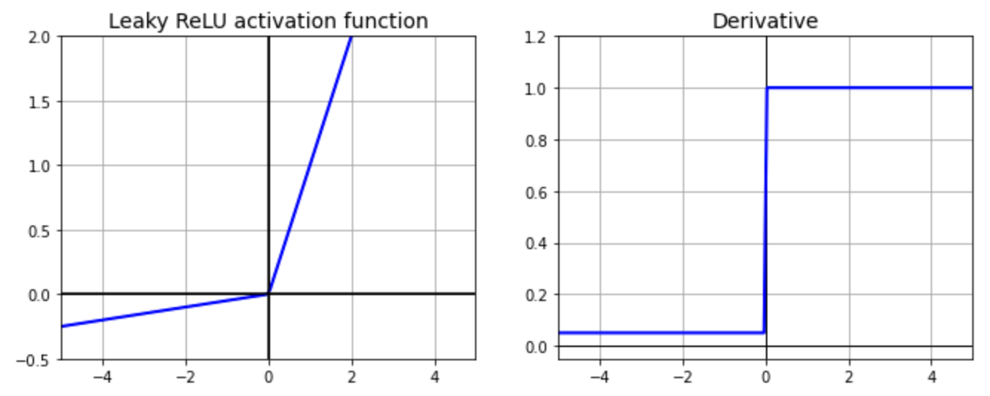
Non-saturating Activation Functions
x
f⁽¹⁾
f⁽²⁾
f⁽³⁾
f⁽⁴⁾
L
input
w1
w2
w3
w4
y
Leaky ReLU
Parameters
Label
Solution 1: Avoid saturating activation functions (e.g., Sigmoid and Tanh)
To further mitigate this issue, we can use Leaky ReLUs
In this case, we propagate a gradient > 0 even when x < 0.
Notes:
This causes the final gradient to be small as well.

Slide 14
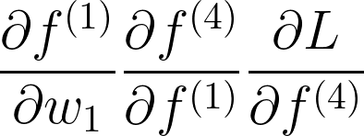
Gradient Shortcuts
shortcut
x
f⁽¹⁾
f⁽²⁾
f⁽³⁾
f⁽⁴⁾
L
input
+
w1
w2
w3
w4
y
Parameters
Label
One way to mitigate vanishing gradients is to add gradient shortcuts in the model.
The idea is to add connections that shorten the gradient path from the loss to the early layers.
Shorter Path
Fewer multiplications
Larger Gradient
Examples are residual networks, skip connections, dense blocks, highway connections, and attention models.
Notes:
This causes the final gradient to be small as well.

Slide 15
Residual Networks
Residual Connections
x
x
f⁽¹⁾
f⁽²⁾
f⁽³⁾
f⁽⁴⁾
L
f⁽¹⁾
dot
input
W⁽¹⁾
w1
w2
w3
w4
y
ReLU
Parameters
Label
Residual networks add shortcuts across hidden layers.
dot
f⁽²⁾
W⁽²⁾
These models are called Residual Networks because each layer has to model a distribution that is the difference between the current distribution and the one in the previous layer.
Residual networks work well when several hidden layers are employed. In this case, the difference in the distribution learned in two consecutive layers is small and it is easier to learn the residual rather than the full distribution.
ReLU
……
Notes:
This causes the final gradient to be small as well.

Slide 16
Skip Connections
Skip Connections
x
z1
z2
z3
x
f⁽¹⁾
f⁽²⁾
f⁽³⁾
f⁽⁴⁾
L
z1
z2
z3
input
f⁽⁴⁾
dot
W⁽⁴⁾
w1
w2
w3
w4
y
Parameters
Label
Skip connections are direct connections between each hidden layer and the last one.
L
The last hidden layer sums up the features coming from all the previous layers.
Notes:
This causes the final gradient to be small as well.

Slide 17
DenseNet
Skip Connections
x
f⁽¹⁾
f⁽²⁾
f⁽³⁾
f⁽⁴⁾
L
z1
z2
z3
input
w1
w2
w3
w4
y
Parameters
Label
In DenseNet each hidden layer takes in input the features from all the previous layers.
This model introduces a lot of gradient shortcuts that help fight vanishing gradients.
Notes:
This causes the final gradient to be small as well.

Slide 18
Normalization

Slide 19
Normalization
Many learning algorithms struggle when the input features take values on very different scales or with very different biases.
scales: [-0.001,0.001] vs [-1000,1000]
biases: [-1, 1] vs [999, 1001]
X2
X2
Large variability
X1
X1
Small variability
Notes:
This causes the final gradient to be small as well.

Slide 20
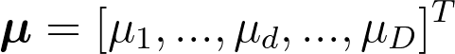
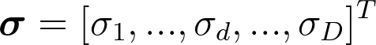
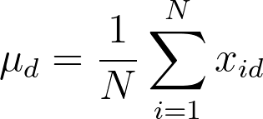
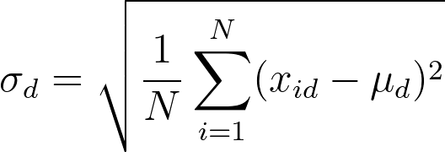
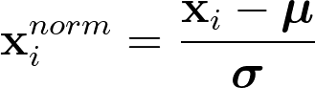
Normalization
There are different ways to normalize the input features.
One popular approach consists to shift and scale each feature so that its mean is zero and its variance is one.
Input Features
Mean (for each feature)
Standard deviation (for each feature)
x11, x12, x13, ………………………….x1D
x21, x22, x23, ………………………….x2D
x31, x32, x33, ………………………….x3D
x41, x42, x43, ………………………….x4D
x51, x52, x53, ………………………….x5D
x61, x62, x63, ………………………….x6D
x71, x72, x73, ………………………….x7D
x81, x82, x83, ………………………….x8D
x91, x92, x93, ………………………….x9D
X=
Number of Samples
Number of features
Notes:
This causes the final gradient to be small as well.

Slide 21


Batch Normalization
So far, we applied normalization to the input features only.
Can we normalize the features learned in the hidden layers as well?
This is a great idea that turned out to speed up neural network training significantly
There are a few complications to consider though:
The internal features change during training (while the input ones do not change)
Normally, we update the parameters using minibatches (SGD) and not using the full training set.
Notes:
This causes the final gradient to be small as well.

Slide 22
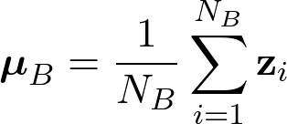
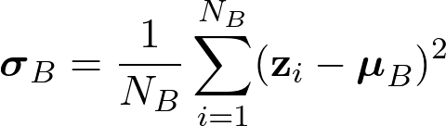
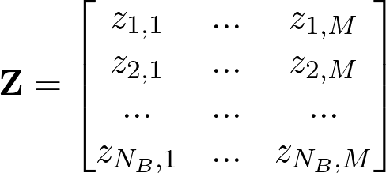
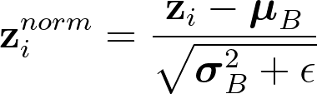
Batch Normalization
Features
Minibatch (NB samples)
Batch Normalization
f1
f2
f3
f4
x11, x12, x13, ………………………….x1D
x21, x22, x23, ………………………….x2D
x31, x32, x33, ………………………….x3D
x41, x42, x43, ………………………….x4D
x51, x52, x53, ………………………….x5D
x61, x62, x63, ………………………….x6D
x71, x72, x73, ………………………….x7D
x81, x82, x83, ………………………….x8D
x91, x92, x93, ………………………….x9D
Compute the minibatch mean:
Number of Samples
2. Compute the minibatch std:
Input
Output (predictions)
Layer1
Layer2
Layer3
Layer4
Z Latent representation to normalize
Normalization Axis
(batch axis)
3. Normalize:
z1
z2
zi
zNB
Notes:
This causes the final gradient to be small as well.

Slide 23
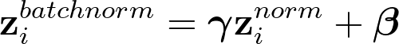
Batch Normalization
Batch normalization is similar to input normalization, but it is computed at a minibatch level in the internal layers.
Batch Normalization
Compute the minibatch mean:
Often, we add additional learnable parameters that allow the neural network to set a mean different than 0 and a variance different than 1.
Scale
Shift
4. Learnable scale and shift:
2. Compute the minibatch std:
3. Normalize:
The scale and shift factors are learned from data (just like any other parameter of the network)
These parameters give more flexibility to the network. In practice, however, they do not change too much during training (γ=1, β=0).
Notes:
This causes the final gradient to be small as well.

Slide 24
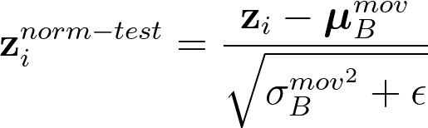
Batch Normalization
What do we do at inference/test time?
At inference/test time, we might even have no minibatches (e.g., think about a user feeding a single image into the model and asking for a prediction).
To avoid this issue, we compute running averages during training (and we used them at inference time):
Notes:
This causes the final gradient to be small as well.

Slide 25
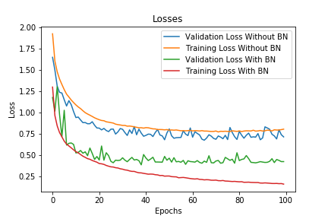
Batch Normalization
Batchnorm significantly speeds up training and generally leads to better convergence:
Its effect is to make the parameter space more “friendly” and easier to optimize.
Training DNNs is complicated by the fact that the distribution of each layer’s inputs changes during training, as the parameters of the previous layers change (internal covariate shift).
This slows down the training because all layers are changed during an update and the update procedure is forever chasing a moving target.
Batchnorm offers a solution to this problem. Even if the distribution of the previous layer changes, at least we can expect it to have a certain mean and variance.
Notes:
This causes the final gradient to be small as well.

Slide 26
Batch Normalization
Few tips and remarks on batch normalization:
You can use batch norm either before or after the non-linearity. In most cases, it is applied before.
You can use larger learning rates. This is because batchnorm makes the network more stable during training.
Batchnorm makes training less sensitive to weight Initialization.
You can it for the input features as well (as a replacement for the input normalization).
Notes:
This causes the final gradient to be small as well.

Slide 27
Layer Normalization
There are different ways to perform normalization.
One other method that has been proven effective is layer normalization.
f1
f2
f3
f4
Layernorm is similar to batchnorm.
The main difference is that the normalization axis is swapped: we normalize over the neuron axis rather than the minibatch .
Normalization Axis
z1
Input
Output (predictions)
z2
Layer1
Layer2
Layer3
Layer4
zi
zNB
Z Latent representation to normalize
Notes:
This causes the final gradient to be small as well.

Slide 28
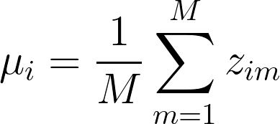
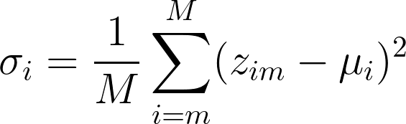
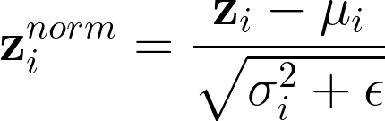
Layer Normalization
What can we do at test/inference time?
Layer Normalization
Due to the choice of the normalization axis, we can do exactly the same computations for both training and test/inference.
Compute the minibatch mean:
We do not need to keep track of the running average and running std as for batchnorm.
2. Compute the minibatch std:
Is layernorm better than batchnorm?
This is not clear in the community as the best technique depends on the task and data used to train the machine learning model.
3. Normalize:
Notes:
This causes the final gradient to be small as well.

Slide 29
Regularization

Slide 30
Regularization
In machine learning we want our model to perform well on new inputs (not observed during training).
This ability is called generalization.
In particular, we want to avoid overfitting, which happens when the training error is low but the test error is high.
Deep Neural Networks are models with large capacity and thus more prone to overfitting problems.
Regularization thus plays an important role.
In the following, we will see popular regularization techniques used in deep learning.
Notes:
This causes the final gradient to be small as well.

Slide 31
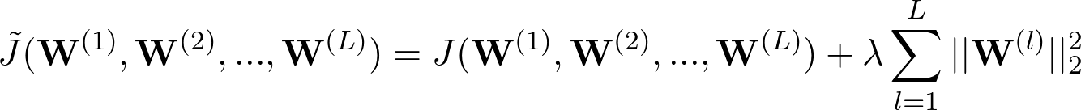
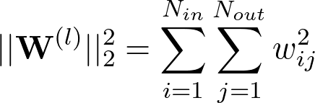
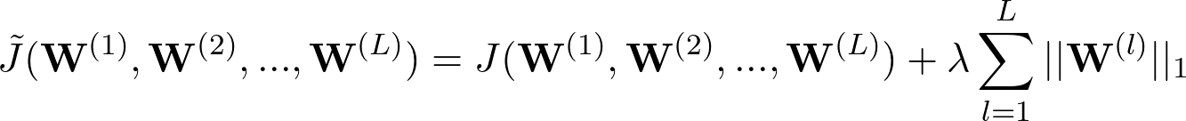
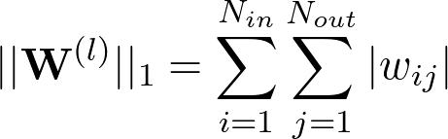
L2 and L1 Regularization
L2 and L1 regularizations are used in the context of deep neural networks as well.
They discourage complex solutions by penalizing the norm of the weights:
L2 Regularization:
L1 Regularization:
Input
Output
Layer1
Layer2
Layer3
Layer4
We apply the penalization factor to all the weights of the deep neural network. In principle, we can use a different regularization factor for each weight matrix. This is normally not done because it introduces too many hyperparameters.
Notes:
This causes the final gradient to be small as well.

Slide 32
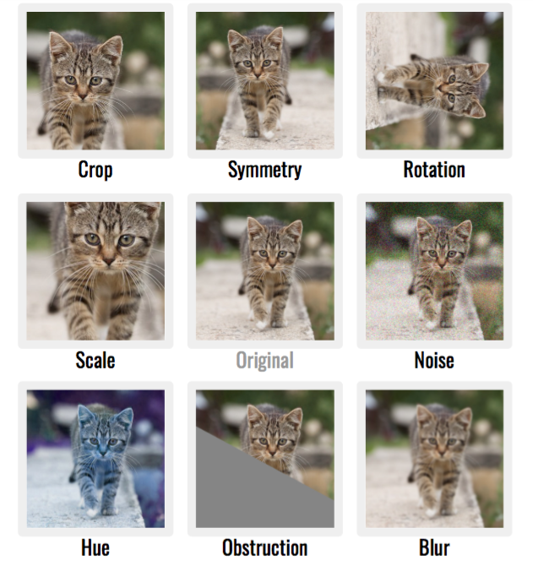
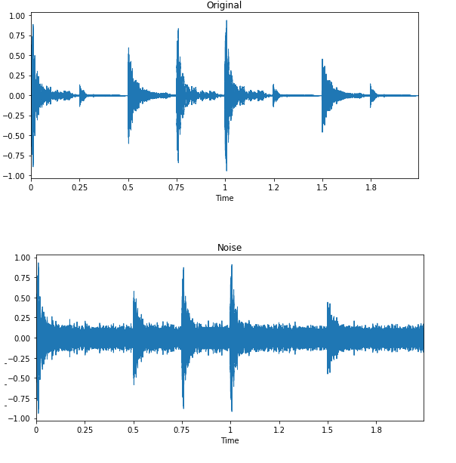
Data Augmentation
The best way to make a machine learning model generalize better is to train it with more data.
If not possible, we can create “fake” training data by applying some transformations to the original data.
This approach is called data augmentation. It is extremely successful for image and audio.
Notes:
This causes the final gradient to be small as well.

Slide 33
Data Augmentation
Data augmentation can be used mainly for classification problems.
One must be careful not to apply transformations that change the correct class.
For instance, in digit recognition, we cannot perform rotations that turn a “6” into a “9” and vice-versa.
Add Noise
Noise injection might also work when noise is applied to the hidden units.
This can be seen as an augmentation applied at different levels of abstraction.
Input
Output
Layer1
Layer2
Layer3
Layer4
Notes:
This causes the final gradient to be small as well.

Slide 34
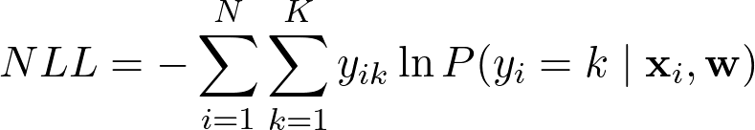
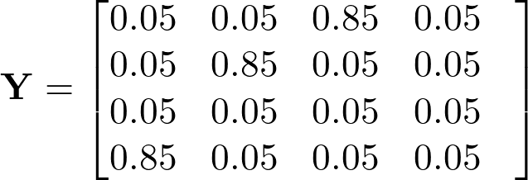
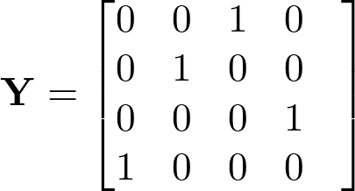
Label Smoothing
In some cases, we regularize a model by making it less overconfident about its predictions.
One way is to replace hard labels with soft labels.
When computing categorical cross-entropy, we can use these soft labels instead of the hard ones:
Soft labels
One-hot encoding (hard labels)
Smooth
Notes:
This causes the final gradient to be small as well.

Slide 35
Multitask Learning
We can improve generalization by solving multiple related tasks at the same time.
Task-specific layers
This approach is called multi-tasks learning.
One common way is to divide the architecture into a shared one (early layers) and a task-specific one (last layers).
Shared layers
Task 1
Example: given a speech recording, task 1 detects phonemes and task 2 classifies speaker identities.
The input must be the same.
Task 2
Input
The shared representation will be much more robust and general as trained with more data on different tasks.
Notes:
This causes the final gradient to be small as well.

Slide 36
Bagging
Bagging is a technique that improves generalization by combining several models.
We can train the models independently and average their predictions at test time.
Model 1
A
V
E
R
A
G
E
Prediction 1
If the models have similar performance and provide uncorrelated errors, the final performance is better than the single predictions.
Model 2
Prediction 2
Final
Prediction
Input
…..
Model N
We can train the models with different data or different architectures.
Prediction N
The main issue is that training multiple models can be very expensive.
Notes:
This causes the final gradient to be small as well.

Slide 37


Dropout
Dropout is a regularization method that efficiently approximates training a large ensemble of neural networks.
During training, some neurons are randomly ignored or “dropped out.”
These neurons are temporarily removed from the network along with their input and output connections.
One way to implement it is to sample a binary mask (that contains 0s and 1s) for each layer and multiply it with the output of the neurons.
Input
Output
Layer1
Layer2
Layer3
Layer4
When we multiply by 0 the neuron is deactivated, while when we multiply by 1 is active.
Element-wise multiplication
The probability of dropping a neuron is called dropout rate ρ.
0.5
0.2
0.0
1.4
0
1
1
1
0.0
0.2
0.0
1.4
=
For every input sample, we sample a different mask.
Notes:
This causes the final gradient to be small as well.

Slide 38
Dropout
The neural networks will be composed of different active neurons for every input.
We sample a “different” network for every input
Input
Output
Layer1
Layer2
Layer3
Layer4
Dropout can be viewed as a cheap way to train ensemble models with an exponential number of architectures.
Element-wise multiplication
0.5
0.2
0.0
1.4
0
1
1
1
0.0
0.2
0.0
1.4
=
Notes:
This causes the final gradient to be small as well.

Slide 39
Dropout vs Bagging
Bagging
Dropout
Model 1
Prediction 1
A
V
E
R
A
G
E
Model 2
Prediction 2
Final
Prediction
Input
…..
Input
Output
Model N
Prediction N
Layer1
Layer2
Layer3
Layer4
The models do not share the weights.
The models share the weights.
We only average a few models.
We average an exponential number of models.
We average the final predictions.
We average internal features.
Notes:
This causes the final gradient to be small as well.

Slide 40
Dropout
We can also see dropout as a way to inject noise into the learning process.
Injecting little noise into the learning process is effective in many cases (think about stochastic gradient descent or data augmentation).
Input
Output
Layer1
Layer2
Layer3
Layer4
Another “angle” to see dropout is to see it as a way to prevent co-adaptation:
… units may change in a way that they fix up the mistakes of the other units. This may lead to complex co-adaptations. This in turn leads to overfitting because these co-adaptations do not generalize to unseen data. […]
Dropout prevents the neurons to rely “too much” on the output of other neurons.
Notes:
This causes the final gradient to be small as well.

Slide 41
Dropout
Training
What do we do at test/inference time?
Dropout is not used at test time.
Input
Output
At test time, we want to use all the ensembled models and not just one.
Layer1
Layer2
Layer3
Layer4
Test
Multiply by (1-p)
At test time, all the neurons are thus active, and we have to scale their outputs properly.
If a neuron is dropped with probability p during training, the outgoing weights of that neuron are multiplied by 1-p at test time.
Input
Output
Layer1
Layer2
Layer3
Layer4
Notes:
This causes the final gradient to be small as well.

Slide 42
Convolutional Neural Networks

Slide 43


Motivation
Convolutional neural networks (CNNs) are simply neural networks that use convolution in place of general linear transformation.
The main difference with MLPs are the following:
Local connections (differently to MLPs that are “fully-connected” models).
Weight Sharing (differently to MLPs that employ different weights for different neurons).

Slide 44

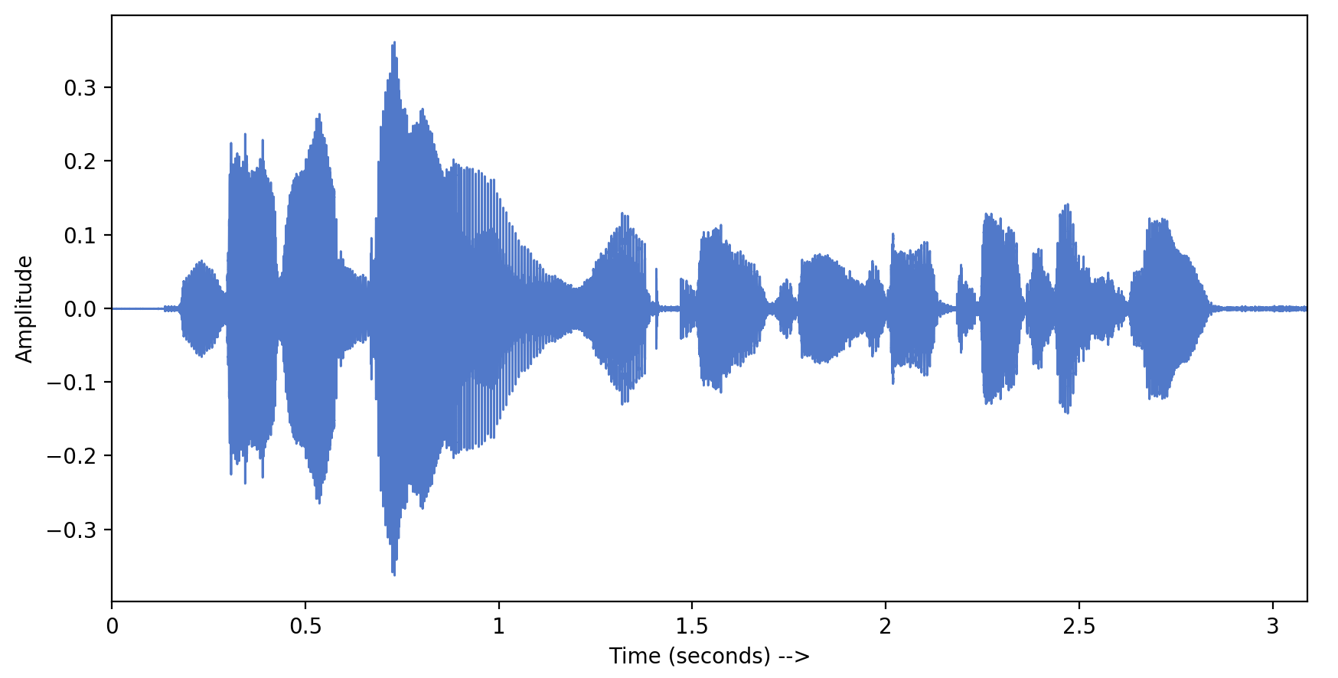
Motivation
Several signals naturally have spatial or temporal correlations (images, audio, etc.).
Local connections can capture local patterns better than fully-connected models.

Slide 45
Motivation
Local patterns can be everywhere in the image.
Thus we can search for all the local patterns by sliding the same kernel (i.e., with the same weights) over all the input.
This way, we have the chance to react to patterns that are in different positions.

Slide 46
What is a convolution?
Convolution is a standard operation, long used in compression and signal processing (DFT), computer vision (“edge detection”), and image processing tools like Photoshop (“custom filter”).
Let’s start with a 1D Convolution:
a1
a2
a3
a4
a5
a6
a7
a8
5
-1
1
0
0
3
5
2
-1
0
4
-2
-3
0
x0
x1
x2
x3
x4
x5
x6
x7
x8
x9

Slide 47
What is a convolution?
Convolution is a standard operation, long used in compression and signal processing (DFT), computer vision (“edge detection”), and image processing tools like Photoshop (“custom filter”).
1D Convolution
a1
a2
a3
a4
a5
a6
a7
a8
5
-1
-1
1
0
0
3
5
2
-1
0
4
-2
-3
0
x0
x1
x2
x3
x4
x5
x6
x7
x8
x9

Slide 48
What is a convolution?
Convolution is a standard operation, long used in compression and signal processing (DFT), computer vision (“edge detection”), and image processing tools like Photoshop (“custom filter”).
1D Convolution
a1
a2
a3
a4
a5
a6
a7
a8
5
-1
-6
-1
1
0
0
3
5
2
-1
0
4
-2
-3
0
x0
x1
x2
x3
x4
x5
x6
x7
x8
x9

Slide 49
What is a convolution?
Convolution is a standard operation, long used in compression and signal processing (DFT), computer vision (“edge detection”), and image processing tools like Photoshop (“custom filter”).
1D Convolution
a1
a2
a3
a4
a5
a6
a7
a8
5
-1
-6
-2
-1
1
……
0
0
3
5
2
-1
0
4
-2
-3
0
x0
x1
x2
x3
x4
x5
x6
x7
x8
x9

Slide 50
What is a convolution?
Convolution is a standard operation, long used in compression and signal processing (DFT), computer vision (“edge detection”), and image processing tools like Photoshop (“custom filter”).
1D Convolution
To make convolution work, we need to do padding at the edges of our input.
a1
a2
a3
a4
a5
a6
a7
a8
5
-1
-6
-2
5
-2
-7
2
Usually, we just add zeros.
The amount of padding depends on the filter (kernel) size.
-1
1
0
……
……
……
w1
w2
w3
Can you guess the total number of zeros to add? Let’s assume an odd kernel size Ks
0
3
5
2
-1
0
4
-2
-3
0
x0
x1
x2
x3
x4
x5
x6
x7
x8
x9
Total
On each side
2p= K_{s}-1
p= (K_{s}-1)/2

Slide 51
Kernel Size
The weights of the filter w are learned from the data.
The length of the convolving filter (which corresponds to the number of learnable parameters) is called kernel Size (K_{s}).
This is an architectural hyperparameter to set. Depending on the kernel size we can embed more or less local information.
a1
a2
a3
a4
a5
a6
a7
a8
K_{s}=3
K_{s}=5
5
-1
-6
-2
5
-2
-7
2
w5
w1
w3
w1
w2
w4
-1
1
w2
w3
0
……
……
w1
w3
……
w2
0
3
5
2
-1
0
4
-2
-3
0
x0
x1
x2
x3
x4
x5
x6
x7
x8
x9

Slide 52
Output Channels
In convolutional neural networks, we want each filter to react to different local patterns.
To capture multiple patterns we have to process the input with many different filters.
For each filter, the convolution produces a “filtered” version of the input that reacts to a different local pattern.
4
-1
1
0
5
8
4
2
All these outputs produced by the convolution are gathered in a single matrix with dimensionality (signal length L x number of output channels).
…
…
…
…
…
…
…
…
…
2
0
-7
2
-1
-2
-6
-1
Output channels
5
-1
-6
-2
5
-2
-7
2
…………………………………………………………….
The number of output channels corresponds to the number of filters.
…………………………………………………………….
0
3
5
2
-1
0
4
-2
-3
0
x0
x1
x2
x3
x4
x5
x6
x7
x8
x9

Slide 53
Input channels
So far, we have assumed single-channel inputs.
The convolutional framework is flexible enough to manage multi-channel inputs as well.
In general, the convolution takes a multi-channel input, filters it with some filters, and returns a multi-channel output.
5
The multi-channel input is processed by a filter of dimensionality (kernel_size x input channels).
5
-1
-6
-2
-2
-7
2
Output channel
0
5
-4
3
-1
2
1
-1
-6
0
0
4
-5
2
0
1
2
-4
-8
0
This operation creates a single output channel.
Multi-channel inputs
0
-1
2
3
-5
1
6
-7
-1
0
0
3
5
2
-1
0
4
-2
-3
0
Kernel size

Slide 54
Input channels
We can process the same multi-channel input with many filters to get multiple outputs
4
-1
1
0
5
8
4
2
Output channels
2
0
-7
2
-1
-2
-6
-1
5
-1
-6
-2
5
-2
-7
2
0
5
-4
3
-1
2
1
-1
-6
0
0
4
-5
2
0
1
2
-4
-8
0
Multi-channel inputs
0
-1
2
3
-5
1
6
-7
-1
0
0
3
5
2
-1
0
4
-2
-3
0
Kernel size

Slide 55
Stride Factor
The stride factor is another hyperparameter of the convolutional layer.
It quantifies the amount of movement (step size) by which we slide a filter over an input.
So far, we have assumed a stride factor = 1. If the stride factor > 1, the effect is to compress (downsample) the input.
Stride factor = 3
a1
5
-1
1
0
0
3
5
2
-1
0
4
-2
-3
0
x0
x1
x2
x3
x4
x5
x6
x7
x8
x9

Slide 56
Stride Factor
The stride factor is another hyperparameter of the convolutional layer.
It quantifies the amount of movement (step size) by which we slide a filter over an input.
So far, we have assumed a stride factor = 1. If the stride factor > 1, the effect is to compress (downsample) the input.
Stride factor = 3
a1
a2
5
-2
-1
1
0
0
3
5
2
-1
0
4
-2
-3
0
x0
x1
x2
x3
x4
x5
x6
x7
x8
x9

Slide 57
Stride Factor
The stride factor is another hyperparameter of the convolutional layer.
It quantifies the amount of movement (step size) by which we slide a filter over an input.
So far, we have assumed a stride factor = 1. If the stride factor > 1, the effect is to compress (downsample) the input.
Stride factor = 3
a1
a2
a3
5
-2
-3
-1
1
0
0
3
5
2
-1
0
4
-2
-3
0
x0
x1
x2
x3
x4
x5
x6
x7
x8
x9

Slide 58
Dilated Convolution
Dilated Convolution is a technique that expands the filter by inserting holes between the its consecutive elements.
This can be done to cover a larger area of the input.
So far, we have assumed a dilation = 1. If dilation > 1, the effect is the following
Dilation = 2
a1
2
-1
1
0
0
0
3
5
2
-1
0
4
-2
-3
0
0
x-1
x0
x1
x2
x3
x4
x5
x6
x7
x8
x9
x10

Slide 59
Dilated Convolution
Dilated Convolution is a technique that expands the filter by inserting holes between the its consecutive elements.
This can be done to cover a larger area of the input.
So far, we have assumed a dilation = 1. If dilation > 1, the effect is the following
Dilation = 2
a1
a2
2
-1
-1
1
0
0
0
3
5
2
-1
0
4
-2
-3
0
0
x-1
x0
x1
x2
x3
x4
x5
x6
x7
x8
x9
x10

Slide 60
Dilated Convolution
Dilated Convolution is a technique that expands the filter by inserting holes between the its consecutive elements.
This can be done to cover a larger area of the input.
So far, we have assumed a dilation = 1. If dilation > 1, the effect is the following
Dilation = 2
a1
a2
a3
2
-1
-3
-1
1
0
0
0
3
5
2
-1
0
4
-2
-3
0
0
x-1
x0
x1
x2
x3
x4
x5
x6
x7
x8
x9
x10

Slide 61
Dilated Convolution
Dilated Convolution is a technique that expands the filter by inserting holes between the its consecutive elements.
This can be done to cover a larger area of the input.
So far, we have assumed a dilation = 1. If dilation > 1, the effect is the following
Dilation = 2
a1
a2
a3
a4
a5
a6
a7
a8
2
-1
-3
1
0
-2
0
-4
-1
1
…………………………….
0
0
0
3
5
2
-1
0
4
-2
-3
0
0
x-1
x0
x1
x2
x3
x4
x5
x6
x7
x8
x9
x10

Slide 62
Stacking Convolutional Layers
….
We can stack multiple convolutional layers to form a deep convolutional network.
ReLU
Optionally, normalization is applied right after the convolution (e.g., layernorm or batchnorm).
LayerNorm
Layer 2
Conv 1D
Then, a non-linearity is applied (e.g., ReLU or LeakyReLU).
ReLU
The set of features after the non-linearity is called feature maps.
Layer 1
LayerNorm
We have one feature map for each output channel of the convolution.
Conv 1D
3
5
2
-1
0
4
x1
x2
x3
x4
x5

Slide 63
Stacking Convolutional Layers
Softmax
After stacking multiple convolutional layers, we can apply a final linear transformation (i.e., the standard “fully-connected” one implemented with dot product).
Linear
Note that the linear layer expects in input a vector, while convolution is providing in output a matrix (with dimension input length x output channels).
Flatten
….
We thus apply a flatten operation, that stacks in a single big vector all the output channels.
ReLU
Layer 1
LayerNorm
Then we can apply a softmax (needed if we are solving a multiclass classification problem).
Conv 1D
3
5
2
-1
0
4
x1
x2
x3
x4
x5

Slide 64
Receptive Field
The receptive field in Convolutional Neural Networks (CNN) is the region of the input space that affects a particular unit of the network.
z₂
Layer 2
The receptive field for the unit z₁ at Layer 1 is 3
(because this output depends on 3 inputs)
z₁
Layer 1
Input
What is the receptive field for unit z₂?
It is 5
The receptive field depends on different factors, including:
Kernel Size
Number of Layers
Stride Factor
Dilation factor

Slide 65
Training
How can we train convolutional neural networks?
As usual, we use gradient descent (and all the variants introduces in lecture 2).
How can we compute the gradient?
As for MLP, we use the backpropagation algorithm.
The expression for the gradient will be different from that derived for an MLP.
Fortunately, PyTorch is going to compute all the gradients of interest for us using its automatic differentiation engine.
All the methods mentioned for MLPs (e.g., initialization, normalization, residual/skip/dense connections) can be used for CNNs as well.

Slide 66
Parameters
How many parameters do we have in 1D convolutional layers?
The number of parameters depends on the kernel size (K_{s}), input channels C_{in}, and output channels C_{out.}
If C_{in}=1 and C_{out}=1
N_{p} = K_{s}
If C_{in}=1 and C_{out}> 1
N_{p} = K_{s}⋅ C_{out}
If C_{in}>1 and C_{out}> 1
N_{p} = K_{s}⋅ C_{in}⋅ C_{out}

Slide 67
2D Convolution
The same mechanism seen for 1D convolutions can be extended to 2D inputs (e.g., images).
In this case, the filters are sliding matrices that process the input:
0 | 0 | 0 | 0 | 0 | 0
0 | 1 | 5 | 3 | 2 | 0
0 | -1 | -3 | -3 | 0 | 0
0 | 0 | 1 | 2 | -1 | 0
0 | -2 | 0 | 0 | 6 | 0
0 | 0 | 0 | 0 | 0 | 0
0 | 5 | 3
-1 | -3 | -3
0 | 1 | 2
2D Kernel (filter)
Input

Slide 68
2D Convolution
The same mechanism seen for 1D convolutions can be extended to 2D inputs (e.g., images).
In this case, the filters are sliding matrices that process the input:
0 | 0 | 0 | 0 | 0 | 0
0 | 1 | 5 | 3 | 2 | 0
0 | -1 | -3 | -3 | 0 | 0
0 | 0 | 1 | 2 | -1 | 0
0 | -2 | 0 | 0 | 6 | 0
0 | 0 | 0 | 0 | 0 | 0
0 | 0 | 1
0 | -1 | 1
1 | 1 | 0
3 | -6 | -7 | -5
3 | 4 | .. | ..
.. | .. | .. | ..
.. | .. | .. | ..
2D Kernel (filter)
Output
Complete it as an exercise
Input

Slide 69
2D Convolution
The 2D convolution is defined by the same hyperparameters seen for the 1D case:
in_channels: Number of channels in the input image (C_{in}).
out_channels: Number of channels produced by the convolution (C_{out}).
kernel_size: Size of the convolving kernel (K_{sx}x K_{sy}).
stride: Stride of the convolution (this time 2D).
dilation: Spacing between kernel elements (this time 2D).
How many parameters do we have in 2D convolutional layers?
N_{p} = K_{sx}⋅ K_{sy}⋅ C_{in}⋅ C_{out}

Slide 70
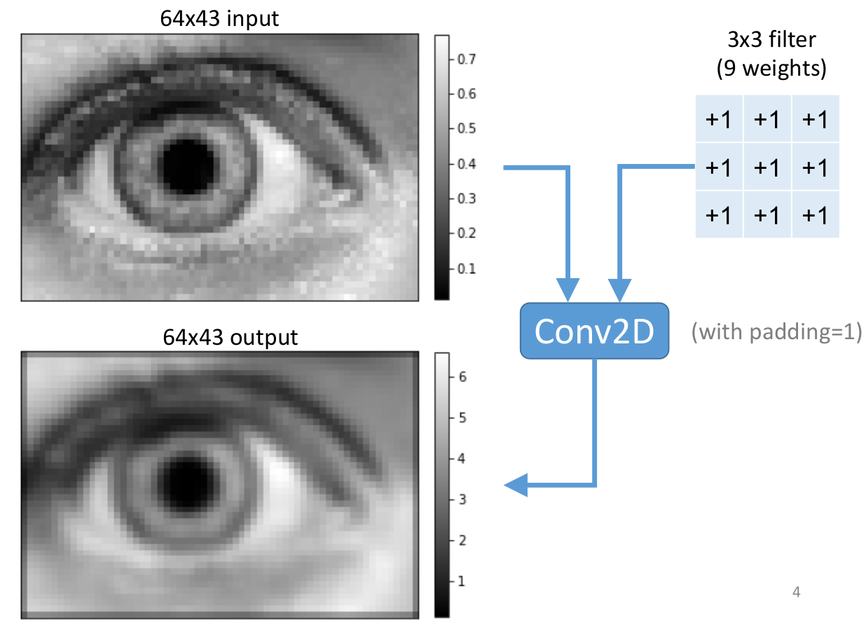
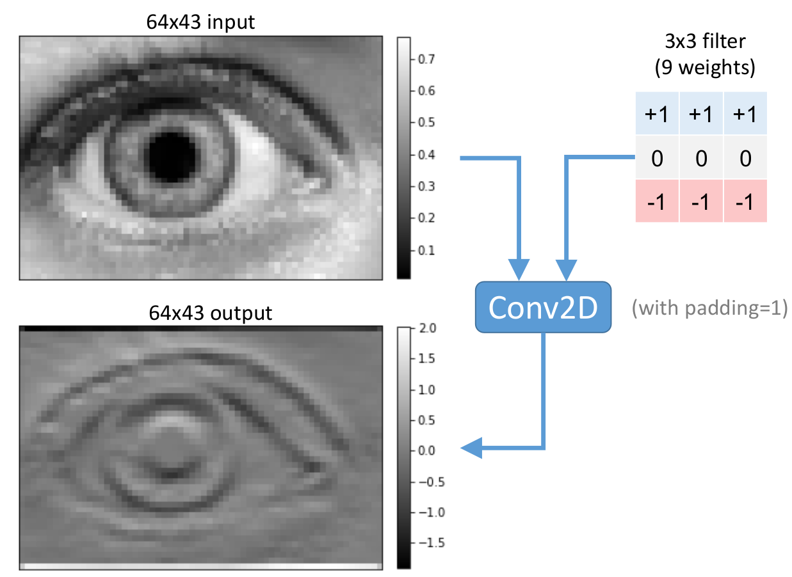
2D Convolution
With 2D convolution, we can visualize more clearly the effect of the convolution.
The effect depends on the weights of the 2D kernel used for the convolution:
This filter makes an image blurry
This filter extracts boundaries

Slide 71
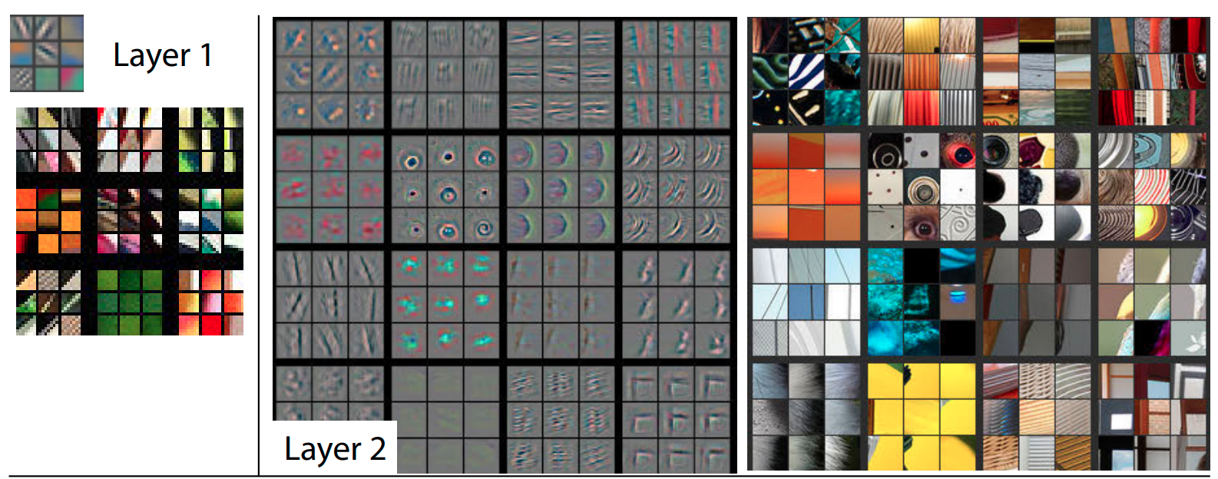
2D Convolution
With CNNs we can effectively learn hierarchical features:

Slide 72
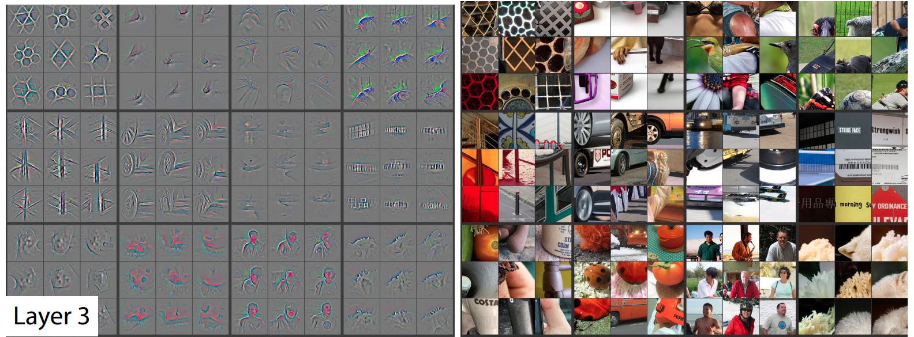
2D Convolution
With CNNs we can effectively learn hierarchical features:

Slide 73
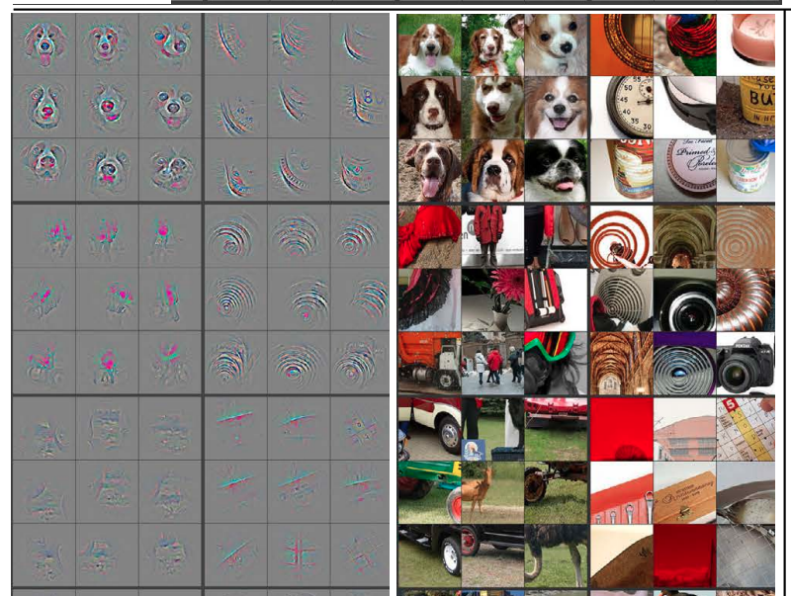
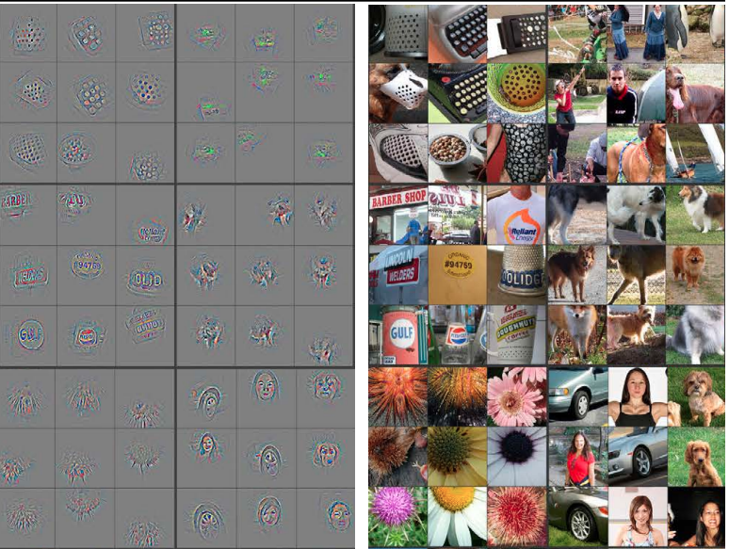
2D Convolution
With CNNs we can effectively learn hierarchical features:
Layer 4
Layer 5

Slide 74
Pooling

Slide 75
Pooling
….
In CNN architectures, we often apply pooling after the non-linearity.
Pooling
Pooling helps to make the feature maps approximately invariant to small translations of the input.
ReLU
This is a useful property if we care whether a pattern is present than exactly where it is.
Layer 1
LayerNorm
Conv 1D
For instance, think about determining if an image contains a face. We don’t need the exact location of the eyes, but rather if they are present
3
5
2
-1
0
4
x1
x2
x3
x4
x5

Slide 76
Pooling
Similar to convolution, pooling is implemented using sliding windows.
The size of the sliding window and its stride factor are hyperparameters of the pooling operation.
Within the window, the pooling outputs a summary of some statistics of its inputs at that given location.
Examples are:
Max pooling, which outputs the maximum element within the window.
Average pooling, which outputs the average of the elements within the window.

Slide 77
Pooling
Max pooling (kernel size = 5, stride=5)
Let’s see an example
3
4
……
……
….
……
Pooling
……
0
0
1
3
0
0
1
4
2
1
ReLU
3
4
……
Layer 1
LayerNorm
……
……
Conv 1D
……
0
0
3
0
0
1
4
2
1
1
3
5
2
-1
0
4
x1
x2
x3
x4
x5
The output of max pooling is the same even if the input is shifted.

Slide 78

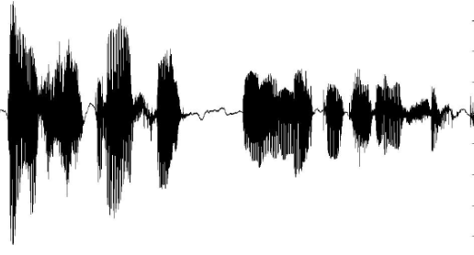
Transposed Convolution
In some cases, we want to upsample a latent representation.
Imagine your model has to predict a speech signal in output (speech enhancement, text-to-speech).
Normally, the model performs most of the computations in a compact latent space. Only at the end we need to predict the full signal.
This requires upsampling your latent representation.
Upsampling
Latent representation
(50 times steps)
Speech Signal
(1600 times steps)

Slide 79
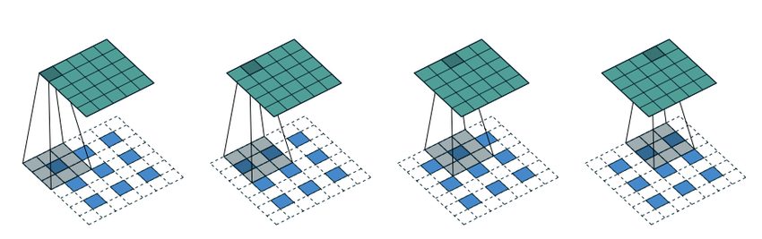
Transposed Convolution
Transposed convolution performs a “learnable” upsampling:
The transposed convolution does exactly what a standard convolution does but on a modified input feature map.
Between each row and column of the input, insert a number of zeros (that depends on the stride factor)

Slide 80
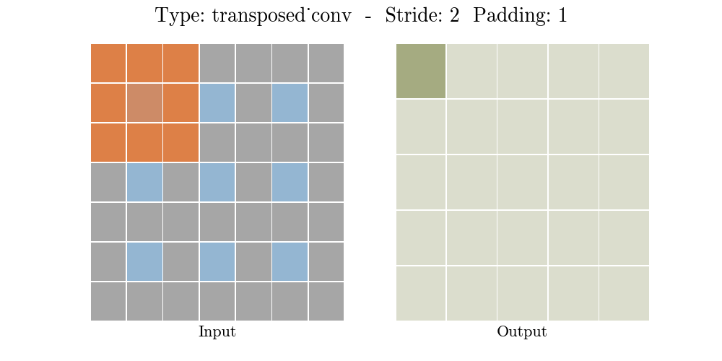
Transposed Convolution
The upsampling factor depends on the stride.
A similar operation (ConvTranspose1d) is defined for 1D signals like audio

Slide 81
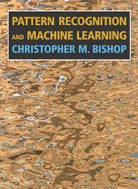
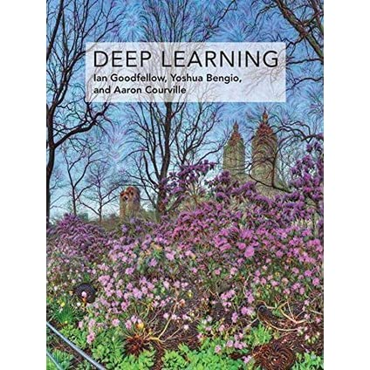


Additional Material & Lab Session
3.1.0 Linear Basis Function Models
4.3.2 Logistic regression
5.0 - 5.4 Neural Networks
5.5.6: Convolutional Networks
Chapter 5: Machine Learning Basics
Chapter 6: Deep Feedforward Networks
Chapter 7: Regularization
Chapter 8: Optimization
Chapter 9: Convolutional Networks
During the weekly lab session, we will do:
Tutorial on CNNs
CNN autoencoder
Deadline: Feb, 6 11.59 pm

Slide 82


